Slide 1
Kube configuration and RBAC in Kubernetes

Slide 2
Service accounts
Service Account:
Service accounts are identities that are intended for use by applications instead of people.
You create a Kubernetes ServiceAccount in a namespace and then assign that ServiceAccount to a Pod by using the serviceAccountName field in the Pod manifest.
Service accounts have the following properties:
Namespaced: Each service account is bound to a Kubernetes Namespace.
Lightweight: Service accounts exist in the cluster and are defined in the Kubernetes API.
Portable: A configuration bundle for a complex containerized workload might include service account definitions for the system's components.

Slide 3
Cluster Authentication using PKI
Kubernetes requires PKI certificates for authentication over TLS. If you install Kubernetes with kubeadm, the certificates that your cluster requires are automatically generated.
Kubernetes requires PKI for the following operations:
Client certificates for the kubelet to authenticate to the API server
Kubelet server certificates for the API server to talk to the kubelet
Server certificate for the API server endpoint
Client certificates for administrators of the cluster to authenticate to the API server
Client certificates for the API server to talk to the kubelets
Client certificate for the API server to talk to etcd
Client certificate/kubeconfig for the controller manager to talk to the API server
Client certificate/kubeconfig for the scheduler to talk to the API server.
Client and server certificates for the front-proxy

Slide 4
Kubeconfig file overview
Defines how to access cluster
Context is defined in kubeconfig file, which has cluster’s location and credentials information.
Kubeconfig file can store multiple configuration contexts. Allows to switch between contexts.
We can also have multiple kubeconfig files.
Kubeconfig is referred by both users and system components to locate and connect with cluster components.

Slide 5
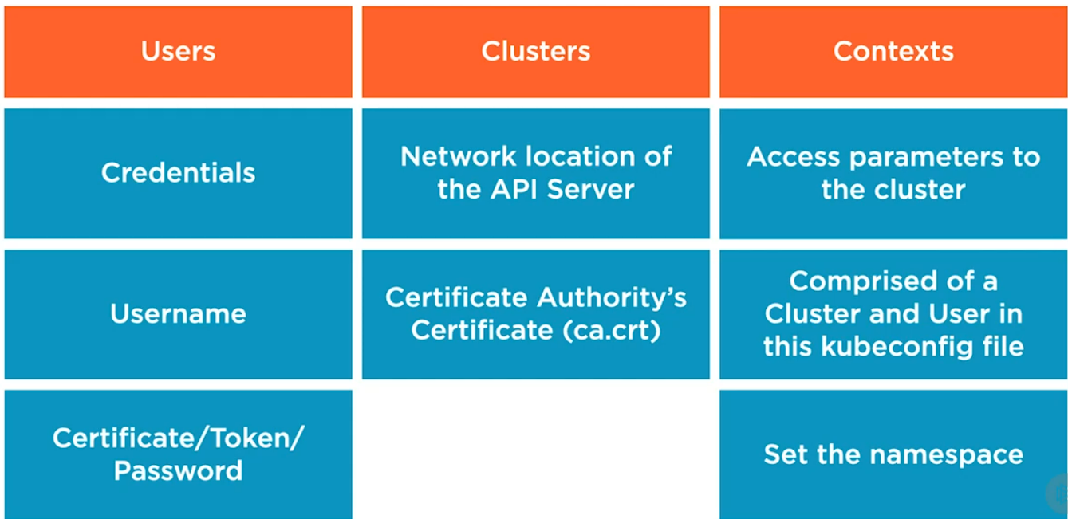
Kubeconfig file components

Slide 6
What’s RBAC
Role Based Access Control
Authorization Plugin enabled on API server
Allowing a requester to perform action on resources in cluster
RESTful API semantics,
Verb or Noun
Default Deny, Rules are written to allow access on resources.
Access is subjected to Users, Groups or Service accounts

Slide 7
What allows to implement RBAC
Role
ClusterRole
Rule definition
RoleBinding
ClusterRoleBinding
TO whom the rules gets implement

Slide 8
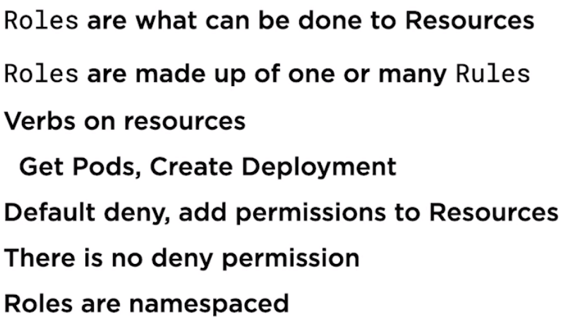
Roles - What’s in it

Slide 9
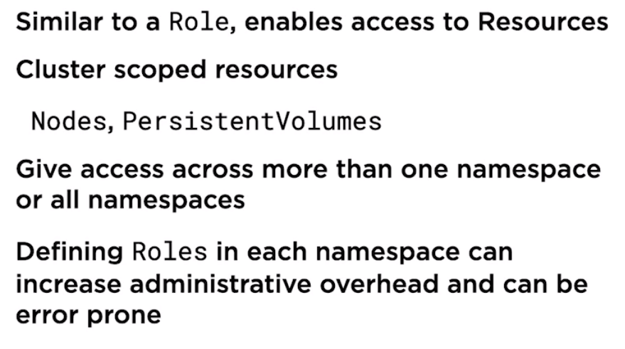
ClusterRole

Slide 10
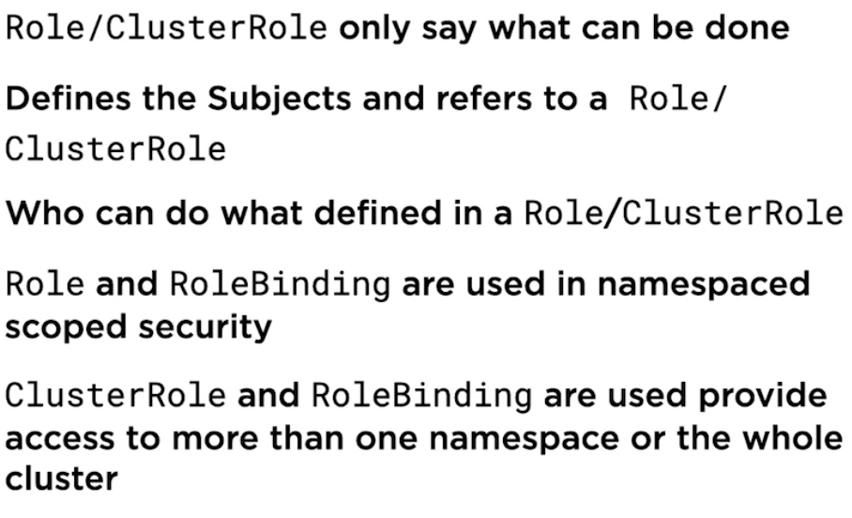
RoleBinding and ClusterRoleBinding

Slide 11
When to use what?
Use Roles and RoleBinding to scope security to a single a namespace. Example, we want a group or a developer to get access to resources within a specific namespace.
Use ClusterRole and RoleBinding to scope security to several or all namespaces. Example, Architects who would like to get access to multiple services in multiple apps.
ClusterRole and ClusterRoleBinding to scope security to all namespaces or cluster-scope resources. Example cluster admins

Slide 12
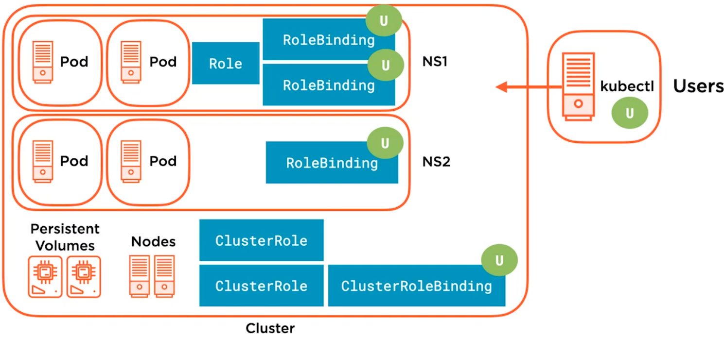
RBAC in the Cluster
Roles and ClusterRole defined with Rules stated using verbs, Nouns. Defines access for action that can be performed on which resources.
RoleBinding, defines who (subject) will get access to perform what action. ClusterRoleBinding defines who (Subject) will get access to perform what on clusterwide resources.

Slide 13
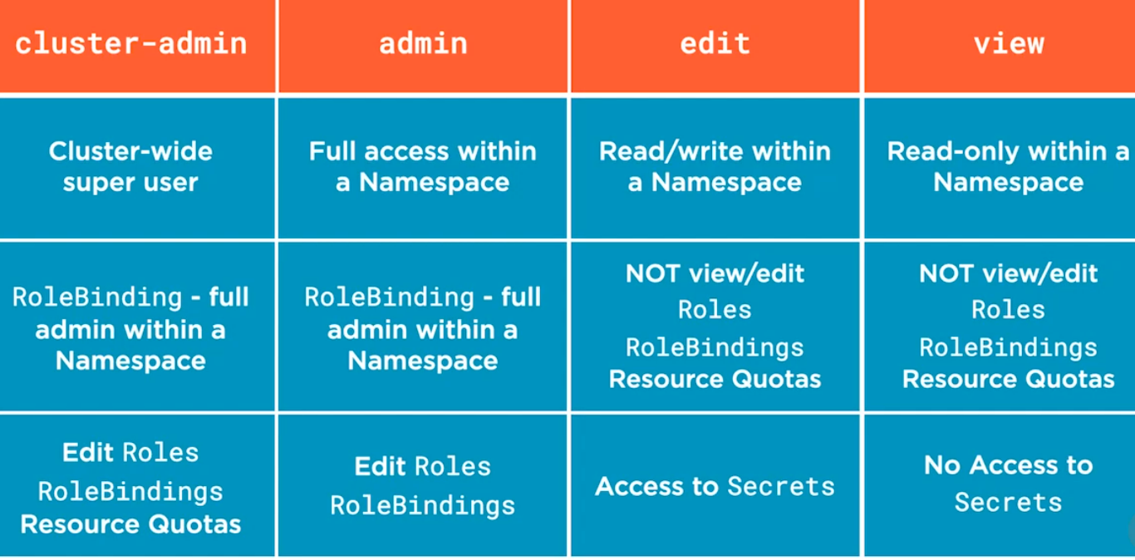
Default ClusterRole

Slide 14
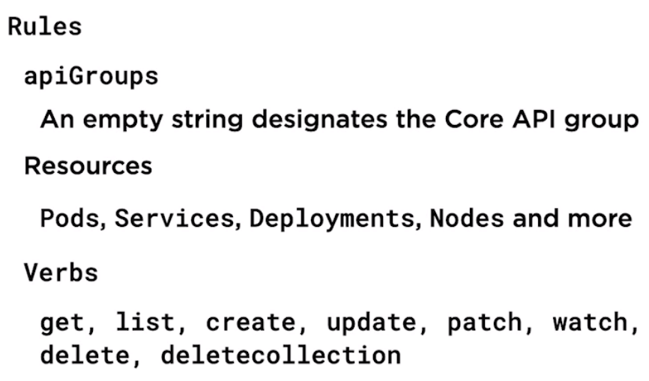
Rules Declaration
With in a Role, the definition consists of below elements as part of rule declaration. Roles / ClusterRole can have several rules defined.

Slide 15
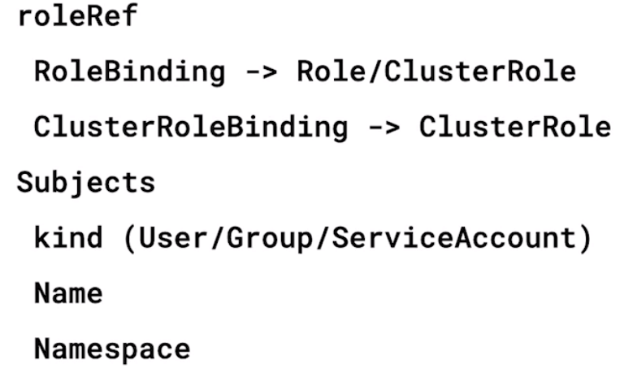
Defining RoleBinding and ClusterRoleBinding

Slide 16
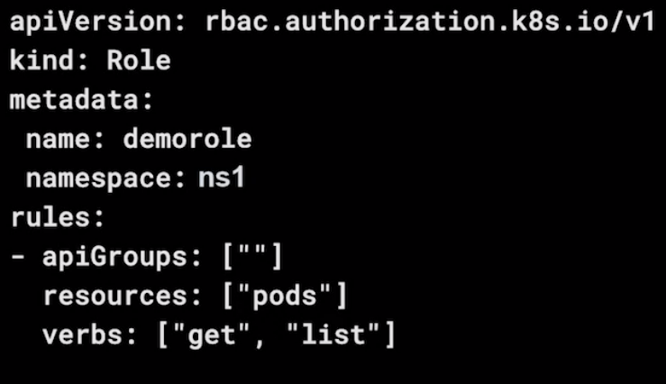
Defining Role Declaratively

Slide 17
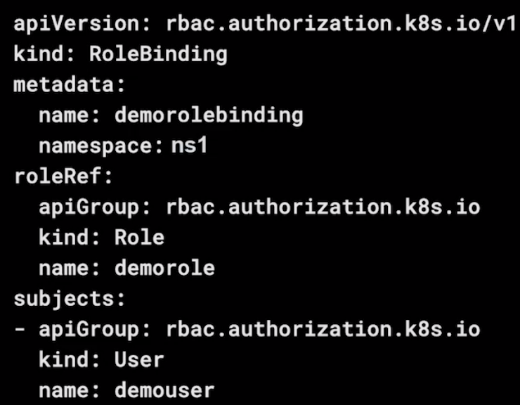
Defining RoleBinding Declaratively

Slide 18
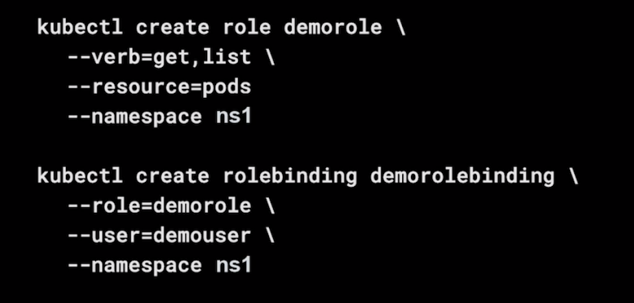
Defining Role and RoleBinding Imperatively

